Slide 1
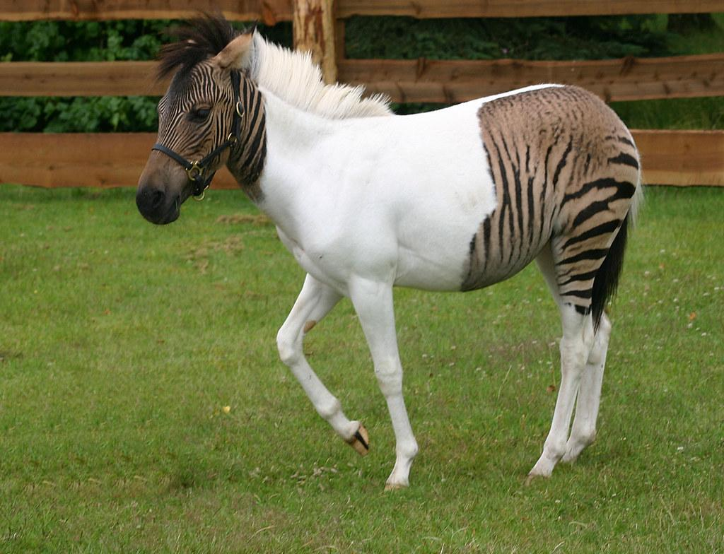
HORSES
VS
ZEBRAS
CLASSIFIER

Slide 2


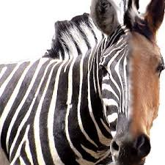
INTRODUCTION
Image classifier is a very useful and important tool so we wanted to experience it. Thus, we chose to do our final project about it. Specifically, we chose to do our classifier about horses vs zebras which is relatively difficult since they share almost identical shape

Slide 3
Our DataSet
We took our dataset form Kaggle website https://www.kaggle.com/arnaud58/horse2zebra.
The Dataset is divided into train, validation and test (the validation is taken from the train)
The images was converted into 150X150

Slide 4
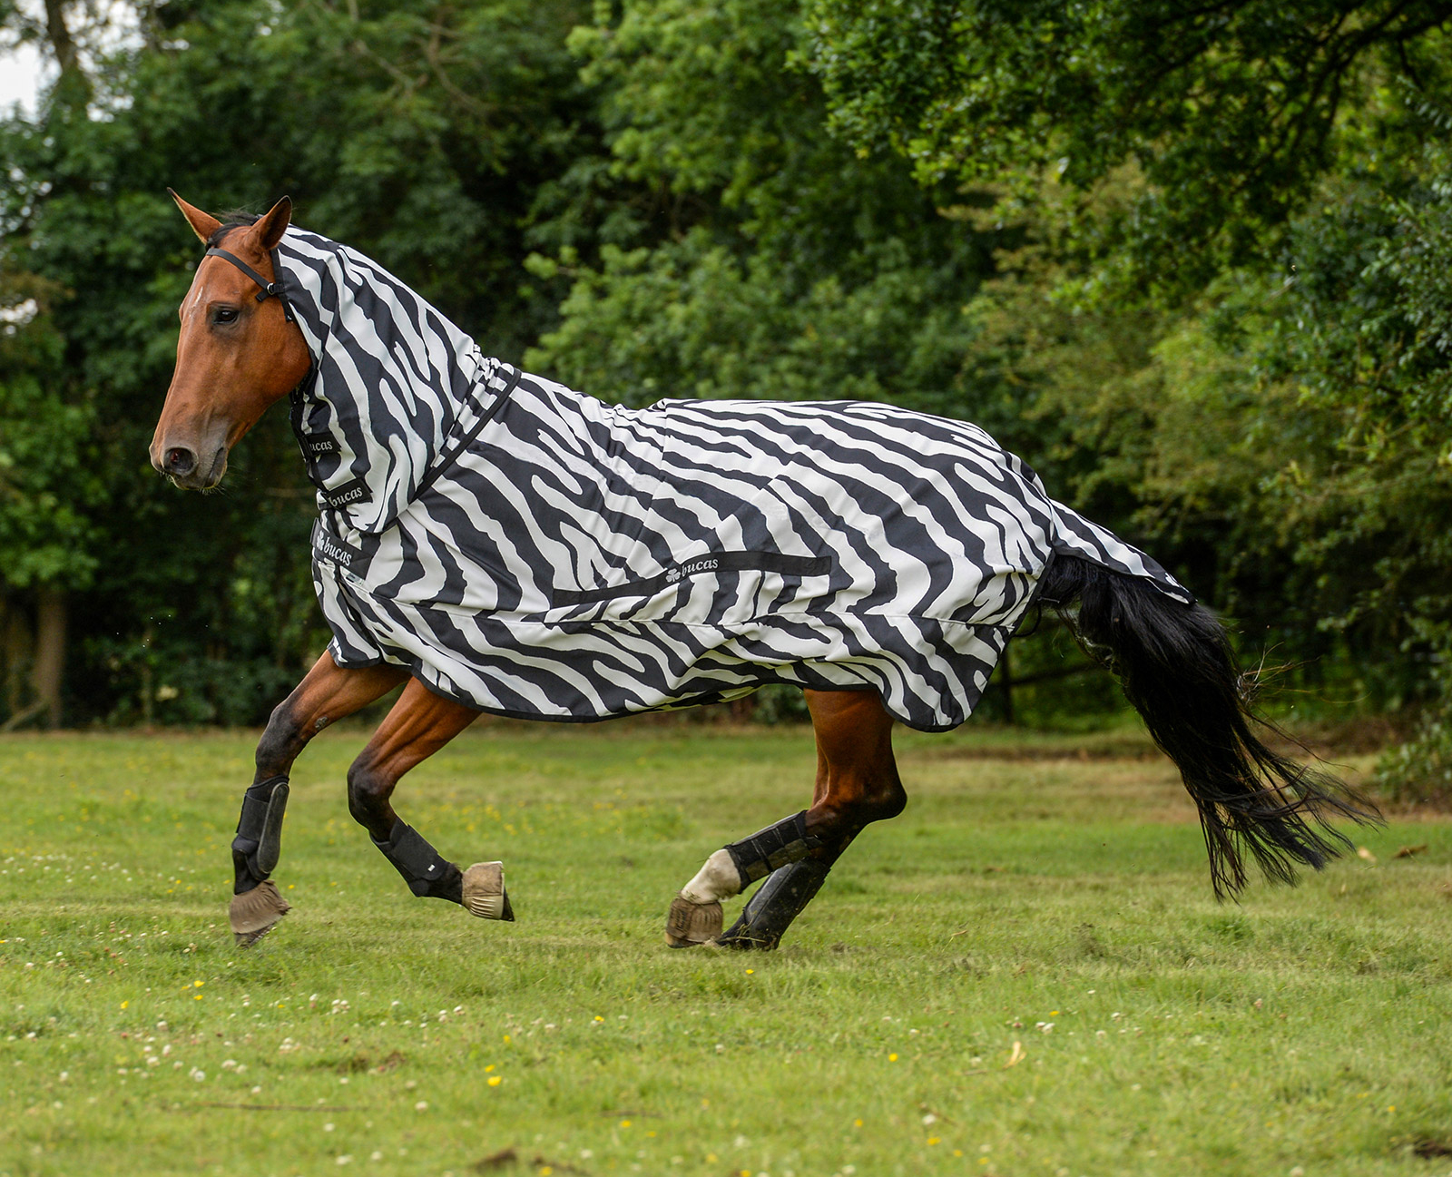
Project process
LOGISTIC
REGRESSION
LOGISTIC
REGRESSION
WITH 2
NEURAL LAYERS
CONVULTIONAL
NUERAL
NETWORK

Slide 5
SIMPLE LOGISTIC REGRESSION
In this stage, we used a simple model of logistic regression without adding neural layers
The model use a big dataset of horses and zebra images.
The model took every pixel of the image as feature for our model
we train it but got bad result.

Slide 6
SIMPLE LOGISTIC REGRESSION
Attempts to improve the model:
Reduce computing time by convert RGB pictures to gray scale.
Normalize the dataset for making the model less sensitive to the scale of the features.
Train error: 0.4235
Test error: 0.4465
Accuracy: 0.6375
Train error: 0.3171
Test error: 0.3870
Accuracy: 0.7708
RGB
GREY SCALE

Slide 7
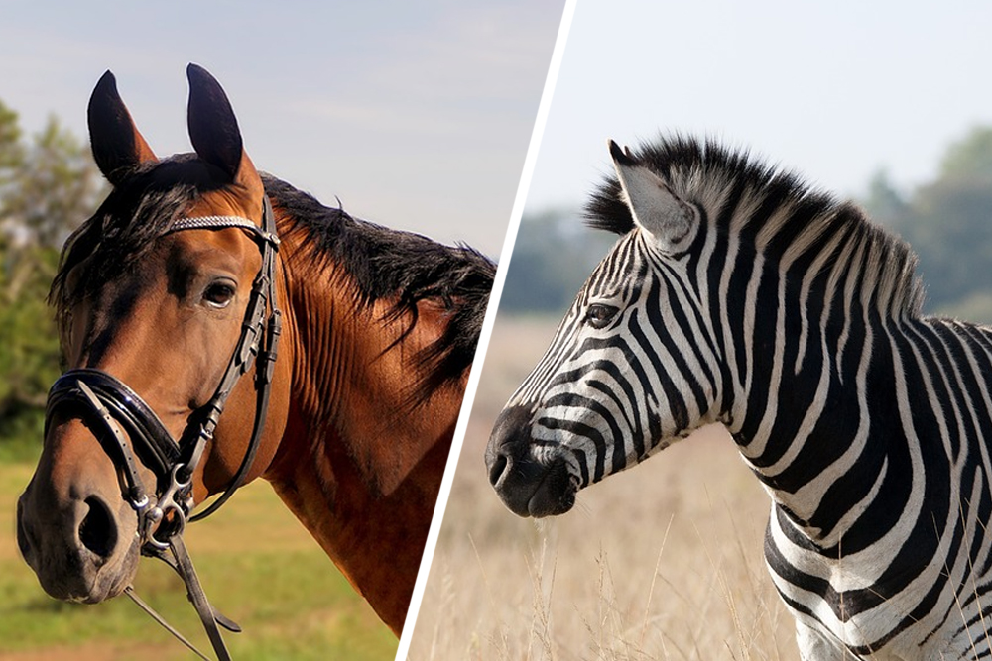
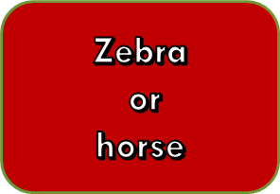
LOGISTIC REGRESSION
WITH ADDING 2 LAYERS
FULLY CONNECTED
100
ReLU
FULLY CONNECTED
50
ReLU
SIGMOID

Slide 8
LOGISTIC REGRESSION
WITH ADDING 2 LAYERS
In this stage, we added 2 layers with relu activation functions to the simple model of logistic regression.
Our attempts to improvement:
Train error: 0.3830
Test error: 0.4574
Accuracy: 0.6750
Train error: 0.4146
Test error: 0.4131
Accuracy: 0.7208
GREY SCALE
RGB

Slide 9

CONVULTIONAL NUERAL NETWORK
Our idea was to use CNN for make a classifier.
When convolutional layers which each of them follow with max pooling.
Notes:
The kernel size of the convolutional layer is 3X3 .
The kernel size of the max pooling is 2X2.

Slide 10
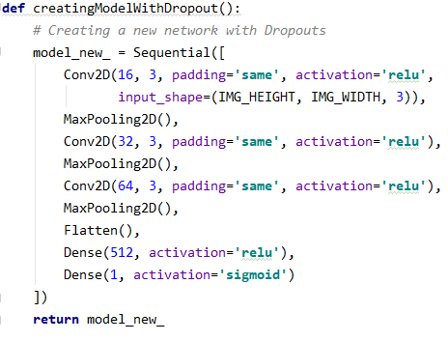
Code view of our model

Slide 11
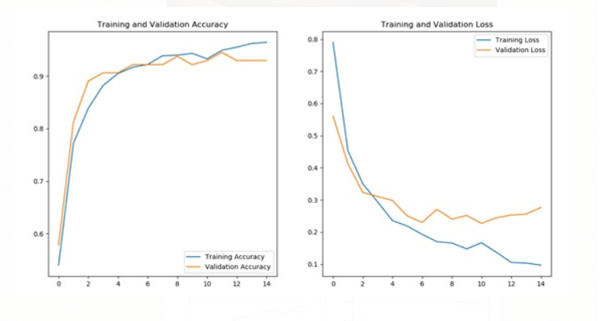
First result
Val Acc : 0.92
Val Loss : 0.26
Over fitting

Slide 12
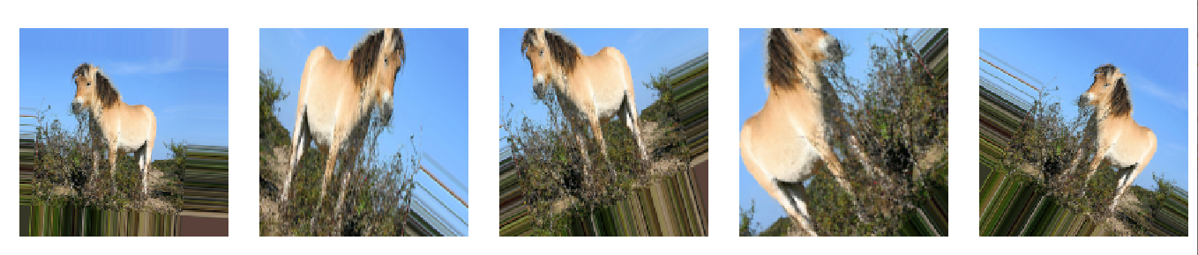
Attempts to fix the overfitting:
we insert dropout layer after the first 3 convolutional layers, which really improved the results.
Augmentation has been added to our Dataset to improve the results.

Slide 13
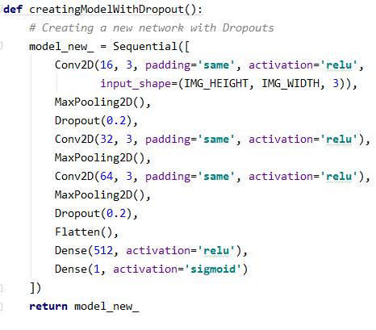
Insert the dropout to the code

Slide 14
Convolutional Neural Networks
Convolution
16
ReLU
Max Pooling
DROPOUT
Max Pooling
Convolution
64
ReLU
Max Pooling
Convolution
32
ReLU
DROPOUT
FULLY CONNECTED
512
SIGMOID
Zebra
or
horse

Slide 15
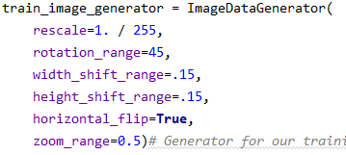
Add augmentation to the code

Slide 16
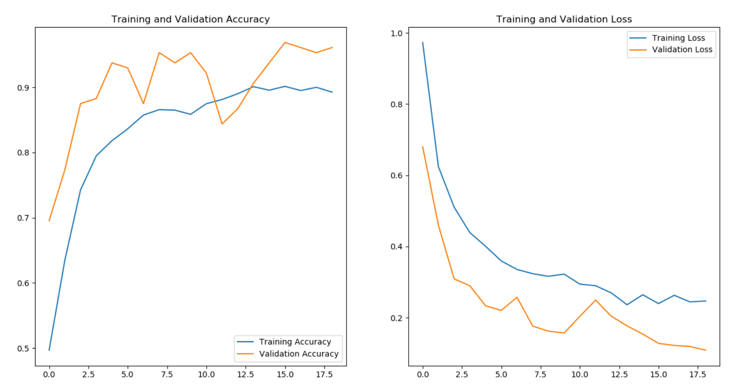
Result after fix the over fitting
Val Acc : 0.96
Val Loss : 0.108

Slide 17
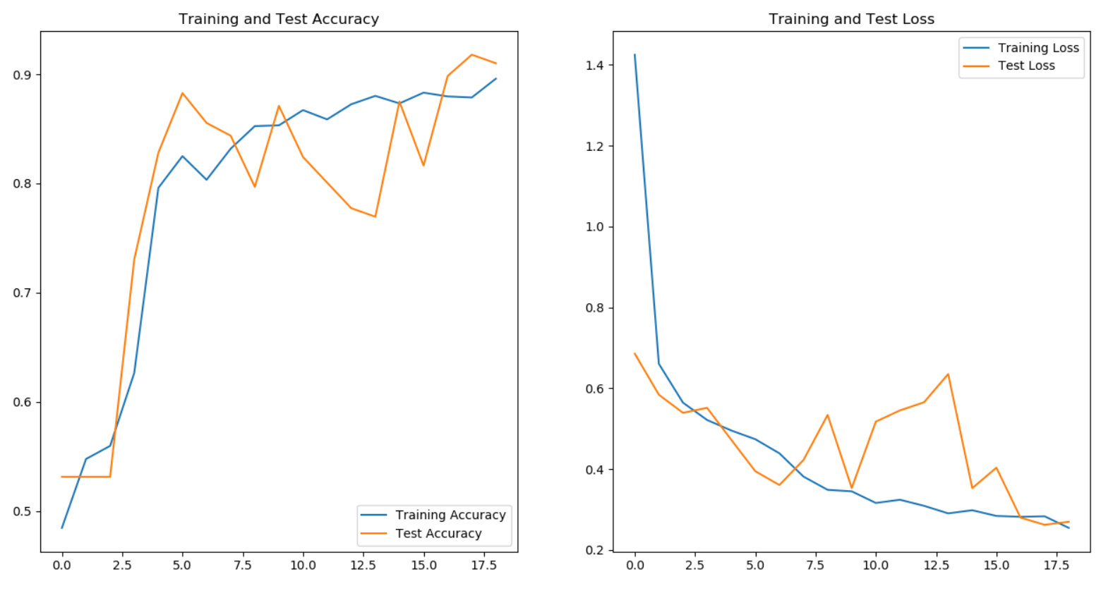
Final result
We let our final model run on the pictures from the test section:
Test Acc : 0.91
Test Loss : 0.26

